Slide 1


SNAPCHAT

Slide 2
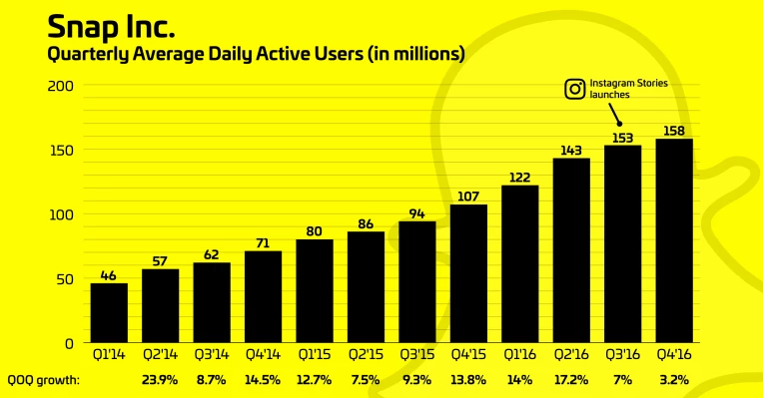
Purpose Summary
Snapchat’s purpose is that its a messaging application but a special feature that separates it from other send messages and photo that deletes itself after you open it

Slide 3
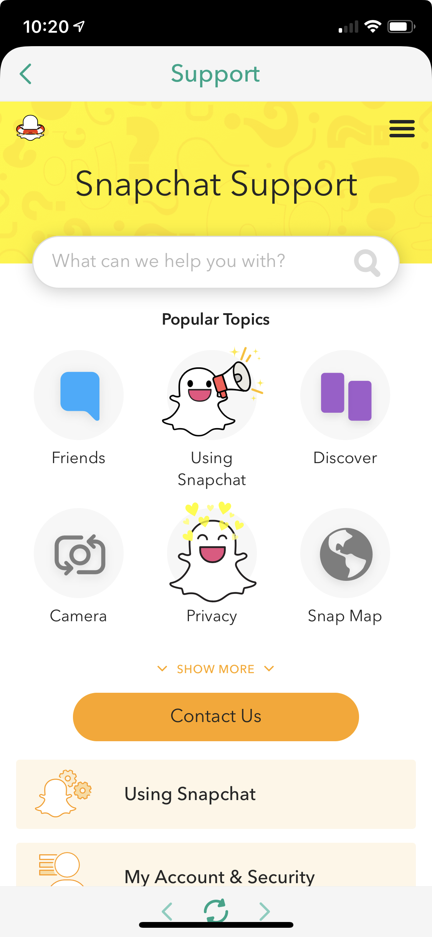
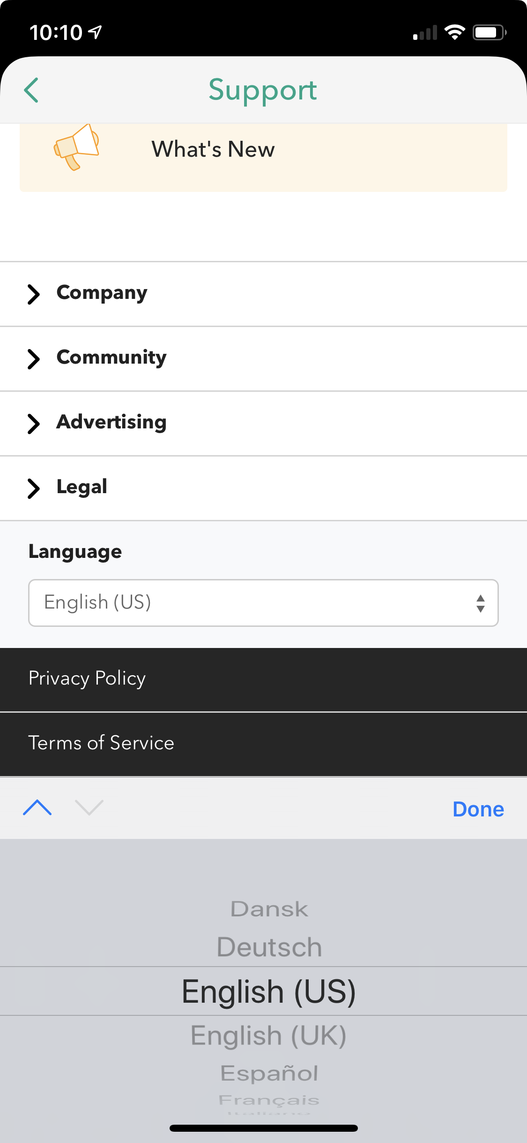
Screen shot of the application related to regionalization

Slide 4
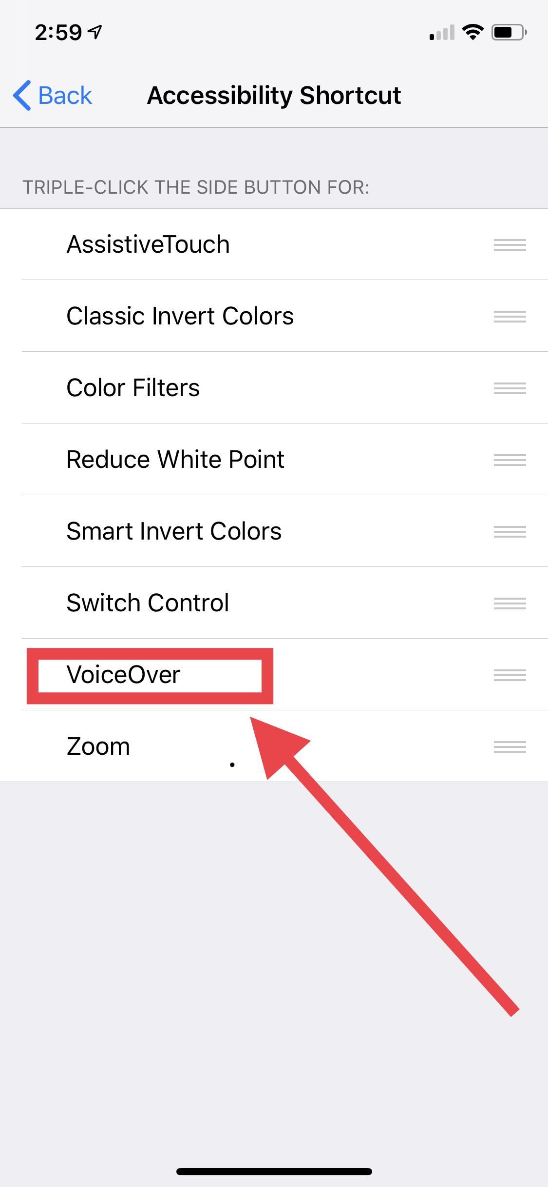
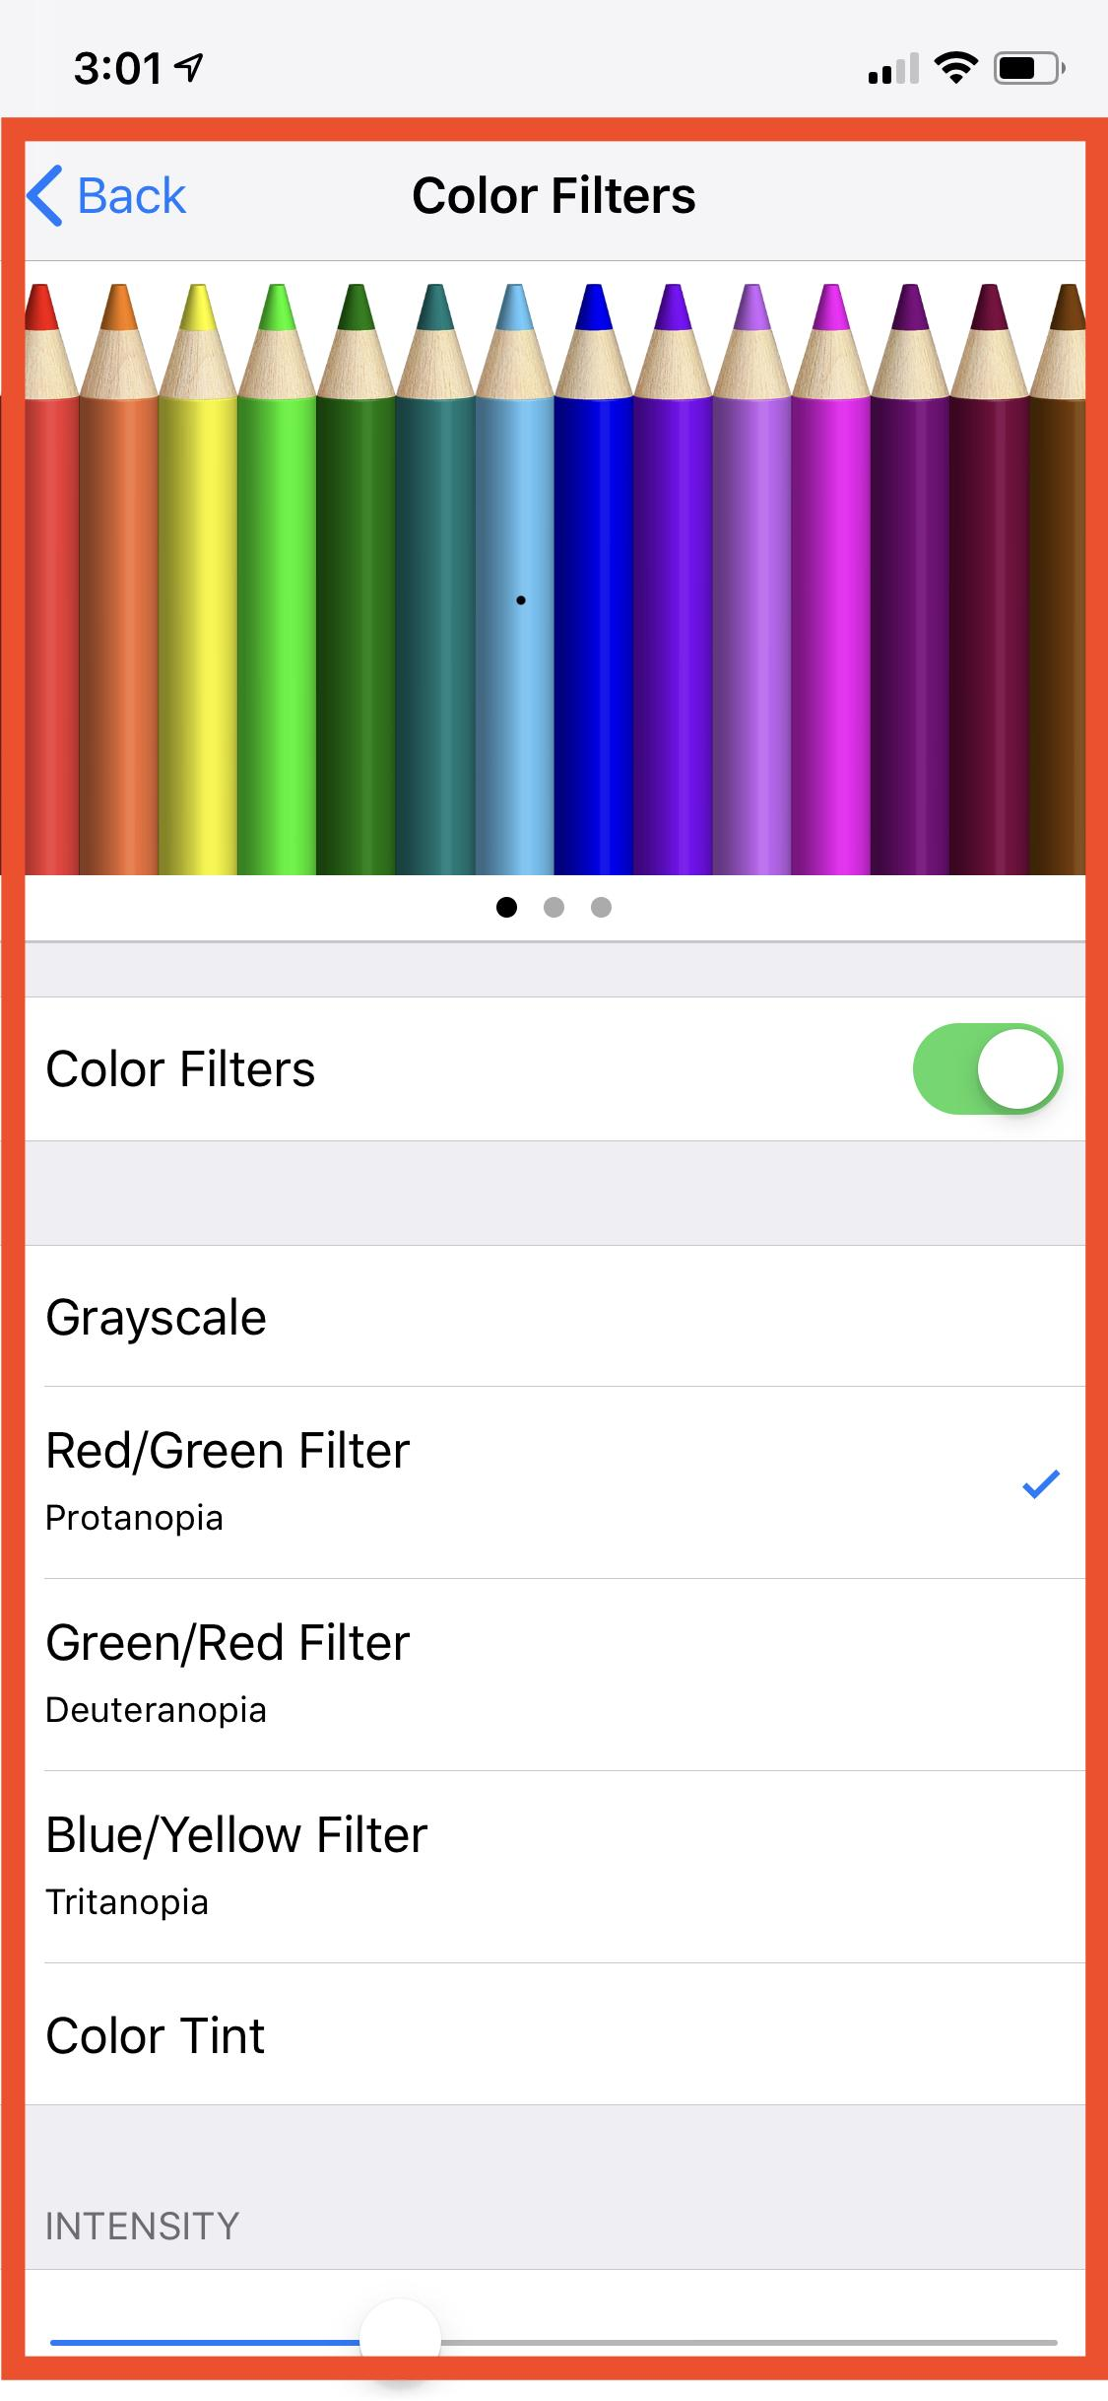
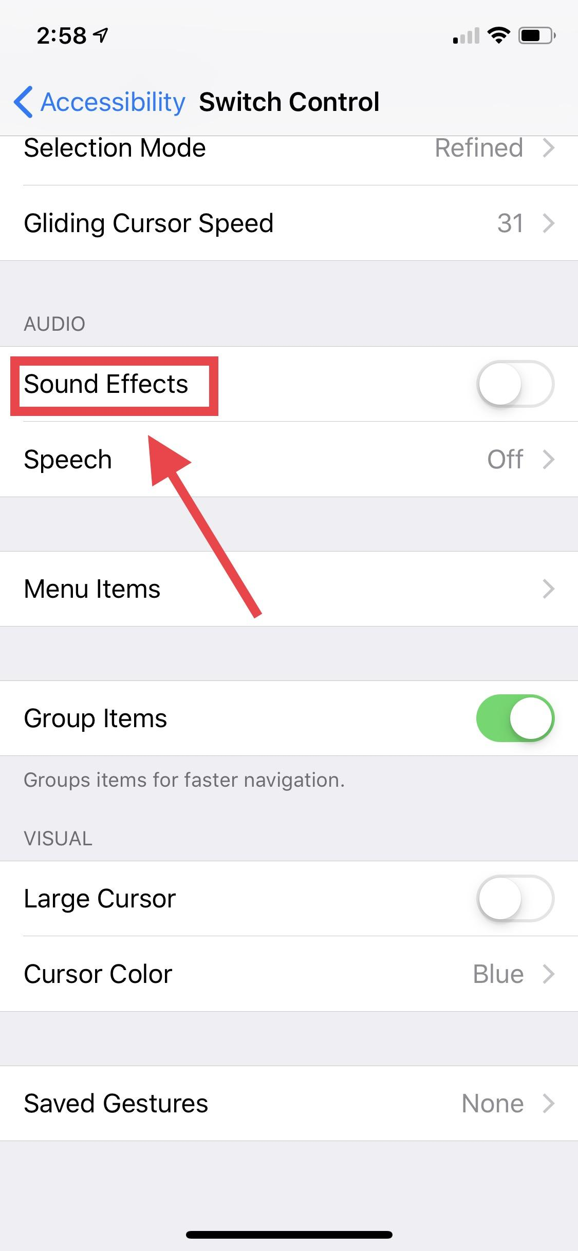
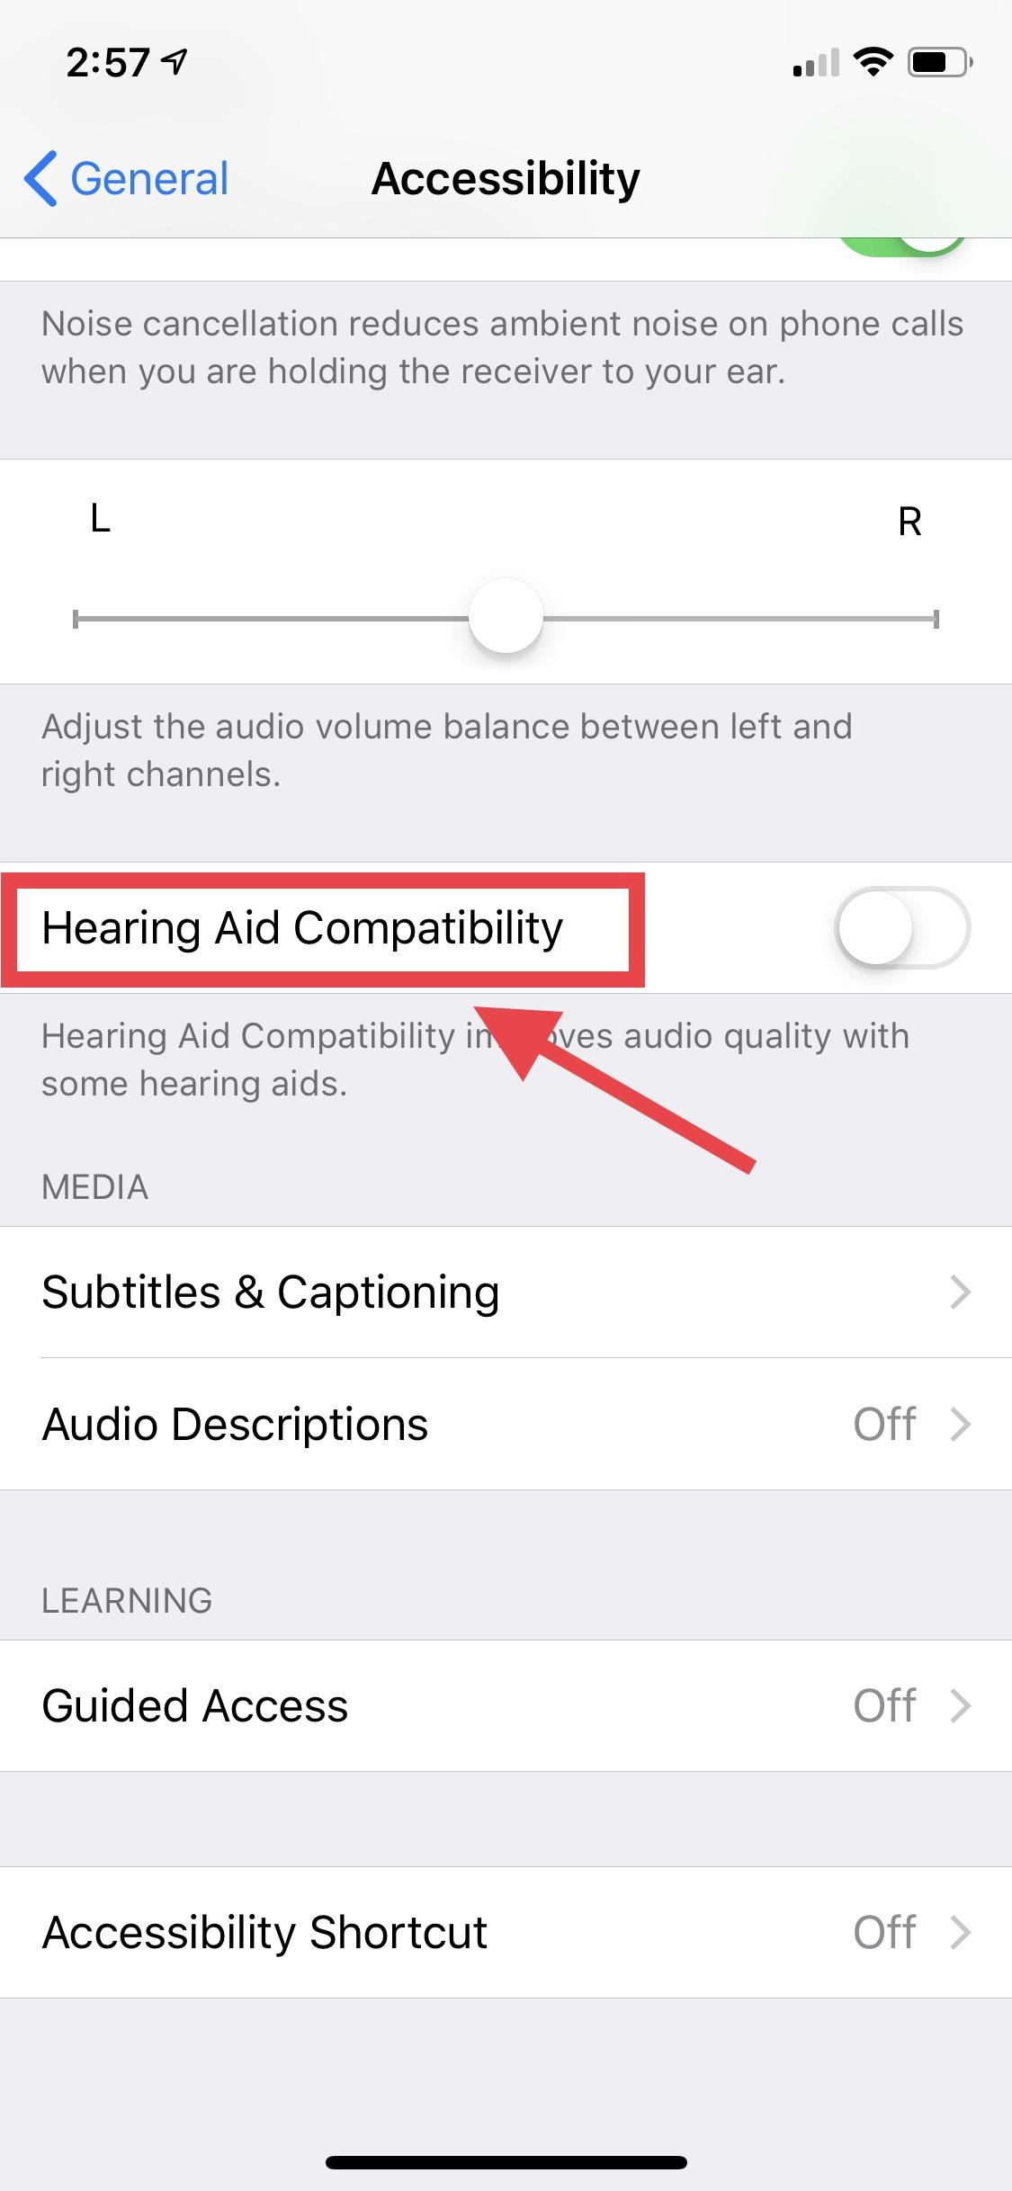
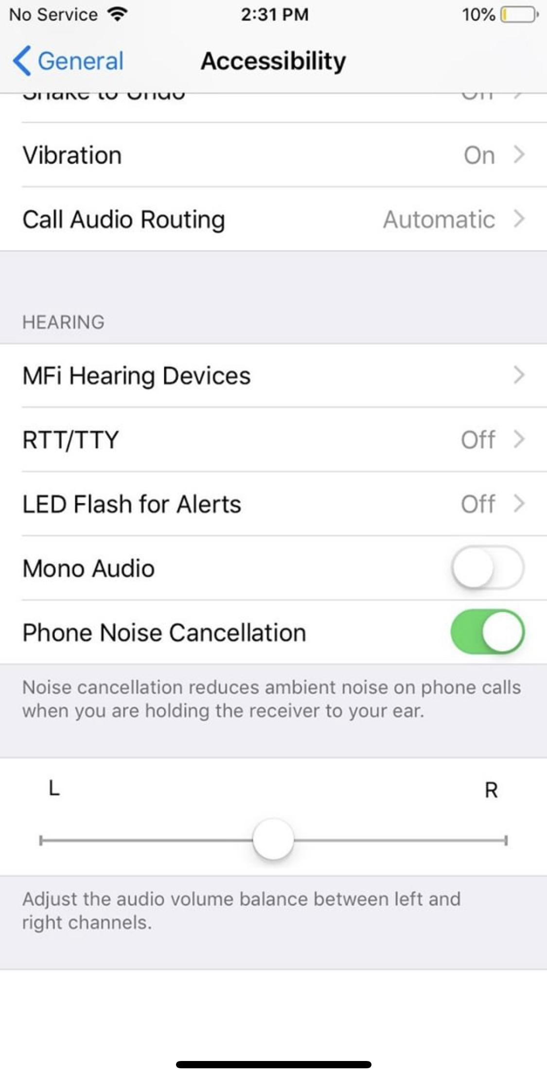
Screen shot of the application related to accessibility

Slide 5
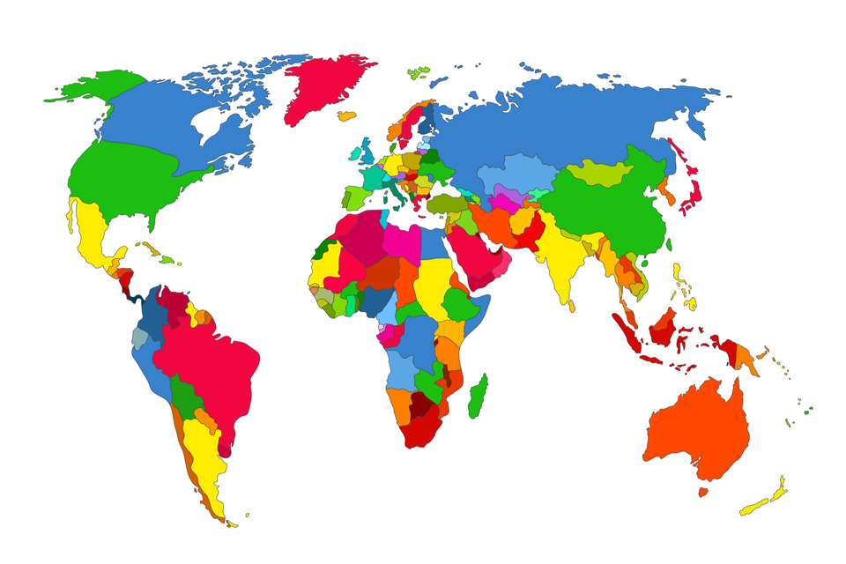
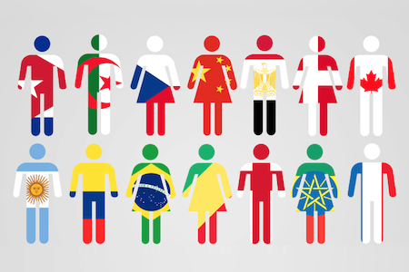
Regionalization

Slide 6
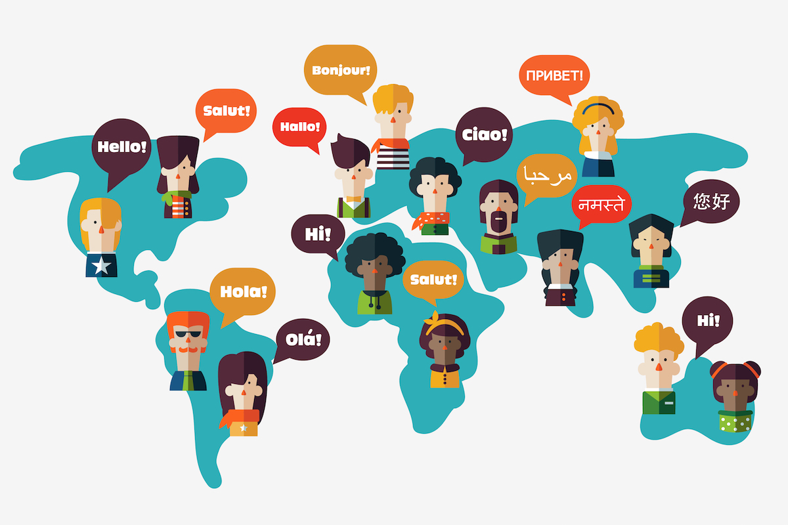
Regionalization
Language
22 languages out of about 6,500 languages spoken in the world are available on snapchat today.

Slide 7
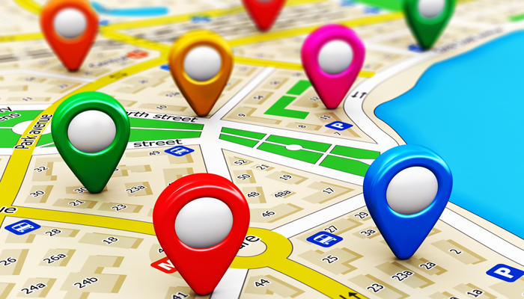

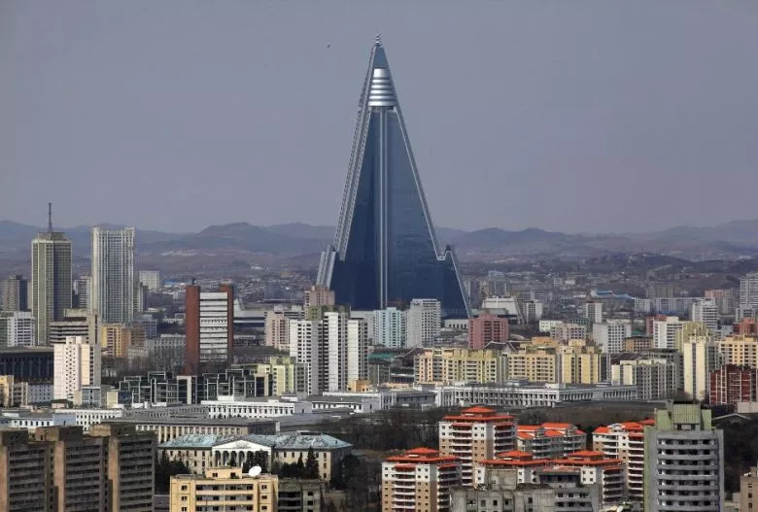
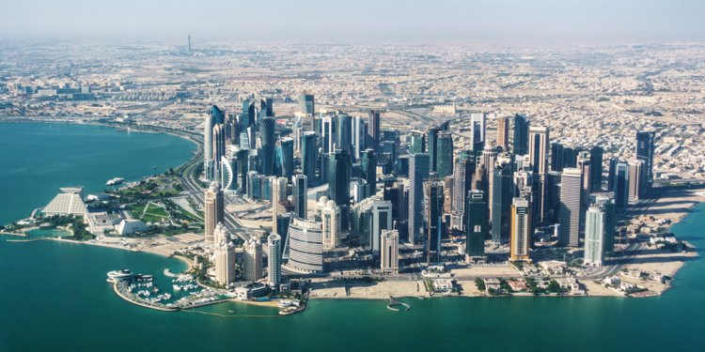

Regionalization
Location
A few places where snapchat is blocked are:
Qatar
Saudi Arabia
UAE
North Korea
China

Slide 8
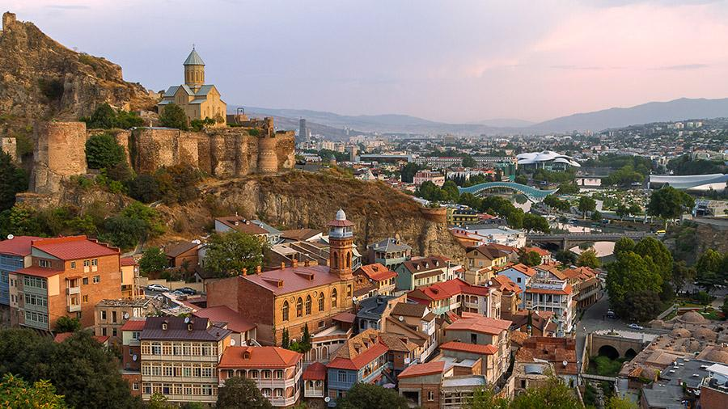
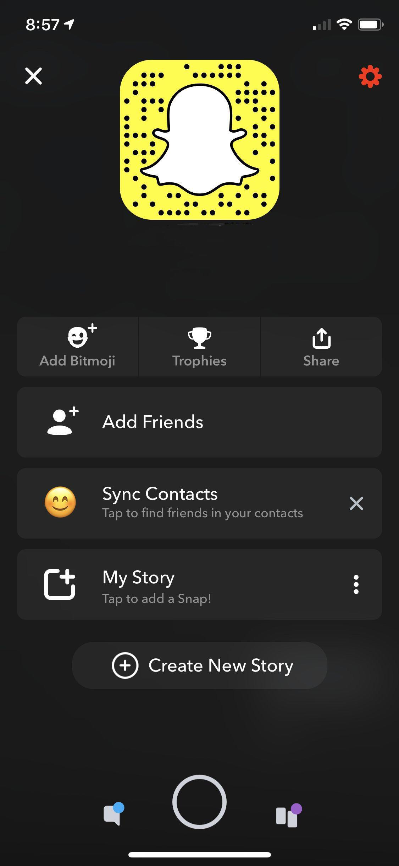
Regionalization
Imagine that the application was designed by a company from a small country like Sweden. Assuming that it would still be designed for North American users, how might it be different from the current application?
If it were designed by a company in a small country the would very much still the same app but might have a few minor changes like the logo and it also might have also had have more of a difficult time launching and knowing what Americans wanted in the app.

Slide 9
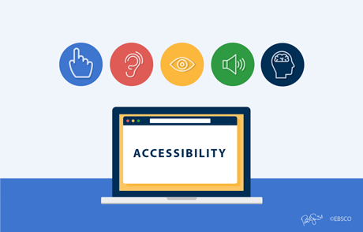
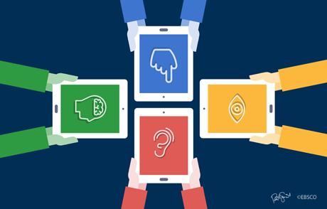
Accessibility

Slide 10

Accessibility
Visually Impaired
People who have this disability will be seeing blurry
No different option because, your friends send you a picture and there will be no explanation
Unless they send video
VoiceOver (Apple) or TalkBack (Android)
Inlargen font or change color of text

Slide 11

Accessibility
Hearing Impaired
Snapchat, unfortunately does not support these people unless you have Hear 'n Aid
VoiceOver or TalkBack will help you for any messages that comes to you
Majority of snapchat are pictures

Slide 12

Accessibility
Motor Coordination
Using snapchat will require your hands only
Not much neck movement
Anybody with a walking disability can use this (People paralyzed waist and below)

Slide 13

Accessibility
Imagine that the application was designed for an impaired person from the ground up. Assuming that it would still be designed for non-impaired users, how might it be different from the current application?
It will be different because they would not be capable to visually see what they’ve received
If friend sends video you can hear
If messaging VoiceOver or TalkBack can help you

Slide 14
Cite
Images
https://www.webwise.ie/parents/explainer-what-is-snapchat-2/
https://neoreach.com/snapchats-3-superpowers/
https://www.management-issues.com/opinion/7040/regionalization-and-the-city-of-the-future/
https://www.ebsco.com/blog/article/building-products-with-user-accessibility-in-mind-an-e-books-case-study
https://www.itu.int/en/ITU-D/Regional-Presence/Europe/Pages/Events/2016/KnowledgeExchange/Knowledge-Exchange-on-ICT-Accessibility-Making-ICTs-Accessible-and-Inclusive-for-All.aspx
https://techcrunch.com/2017/02/02/slowchat/
https://nationalpost.com/news/new-photos-reveal-inside-of-notorious-north-korean-super-hotel-still-unfinished-after-20-years-of-construction
https://www.arcadis.com/en/asia/china/
https://www.businessinsider.com/saudi-arabia-wants-to-turn-qatar-into-an-island-2018-6

Slide 15
Cite
Images
https://www.kerr-recruitment.co.uk/news/view/should-you-develop-your-language-skills
https://www.google.ca/search?q=visually+impaired&safe=strict&rlz=1C1GCEA_enCA839&source=lnms&tbm=isch&sa=X&ved=0ahUKEwiN39Pvpe7gAhVs4oMKHcMbBt4Q_AUIDigB&biw=1680&bih=939#imgrc=o9WuSnpseNYOJM:
https://www.worldatlas.com/articles/how-many-countries-are-in-the-world.html
https://holidayplace.co.uk/blogs/posts/118295/georgia-a-world-of-wonders-in-a-small-country
https://medium.com/mind-dot-blown/a-case-for-regionalization-in-education-3fe52c95cb9d
https://www.ebsco.com/blog/article/from-content-creation-to-content-delivery-how-ebsco-ebooks-builds-an-access
https://houstonima.org/event/luncheon-multicultural-engagement/
https://www.nationalneurotraumasociety.org/symposium/2019-pittsburgh/accessibility
https://www.qatarairways.com/en/qatar-transit-visa.html

Slide 16
Cite
Websites
http://www.perkinselearning.org/technology/blog/app-accessibility-checklist
https://www.quora.com/Whats-the-purpose-of-Snapchat
https://www.digitalinformationworld.com/2018/10/popular-social-media-sites-that-were-or-are-blocked-in-other-countries.html
https://www.infoplease.com/askeds/how-many-spoken-languages

